Slide 1
Téma hodiny: UK Holidays - Christmas
Předmět: English language
Ročník: 2. - 4. ročník střední škola
Klíčová slova: UK, Christmas
Jméno autora: Mgr. Soňa Šípová
Škola: SŠGHS Litoměřice, Dlouhá 6
Smith-Dluhá, Gabrielle a kol. Angličtina-Otázky a odpovědi. Dubicko: INFOA 2008. 978-80-7240-489-6
http://www.christmasholidayseasonfacts.com/images/250px-Juletraet.jpg
http://www.bnr-art.com/santa/images/fatherchristmas.jpg
http://www2.thisisthenortheast.co.uk/inhouse/thisischristmas/images_recipes/pudding.jpg
http://smartcanucks.ca/wp-content/uploads/2009/12/boxing-day-canada1.jpg

Slide 2
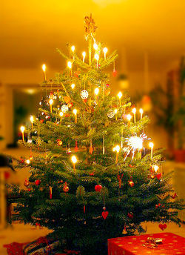
Christmas
Starts on 24th December – Christmas Eve
Families decorate their houses with paper balls and chains, springs of holly, ivy, mistletoe and the Christmas tree
They send and get Christmas cards wishing Merry Christmas and happy New Year
In every house there is the nativity scene with baby Jesus, Three Wise Man, sheep, cows..

Slide 3
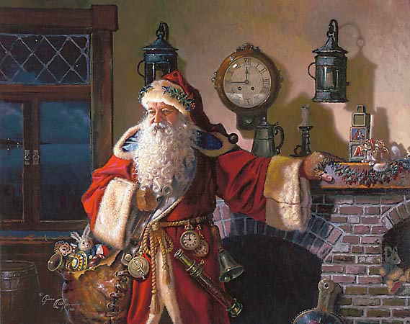
Christmas Day
Children hope that at night Santa Claus will come down the chimney and bring presents for them
There are X-mas stockings hanging from their beds
Children get up very early in the morning to open the presents
They watch TV and sing carols
People have Christmas dinner usually at noon or in the evening
They have roast turkey, potatoes and vegetable

Slide 4
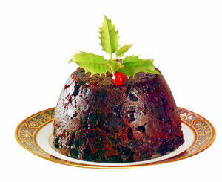
Christmas pudding
A special cake made in advance
Consisting of many ingredients, very heavy food
It is made with butter, fruits, flour
There is a coin inside, for luck

Slide 5

Boxing day
26th December
The second Christmas holidays
Named after the tradition of giving dustmen, newspaper boys, milkmen, postmen, etc. small sums of money in boxes

